Slide 1

K-means Clustering
BY: MUHAMMAD TALHA

Slide 2
CLUSTERING
The organization of unlabeled data into similarity groups called clusters.
Clustering is a task of dividing the data sets into a certain number of clusters in such a manner that the data points belonging to a cluster have similar characteristics. Clusters are nothing but the grouping of data points such that the distance between the data points within the clusters is minimal.

Slide 3
K-Mean Clustering
K-Means clustering algorithm is defined as an unsupervised learning method having an iterative process in which the dataset are grouped into k number of predefined non-overlapping clusters or subgroups, making the inner points of the cluster as similar as possible while trying to keep the clusters at distinct space it allocates the data points to a cluster so that the sum of the squared distance between the clusters centroid and the data point is at a minimum, at this position the centroid of the cluster is the arithmetic mean of the data points that are in the clusters.

Slide 4
Algorithm

Slide 5
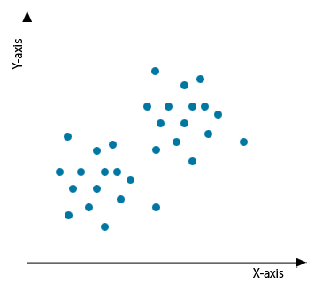
K- Means Clustering Algorithm needs the following inputs:
K = number of subgroups or clusters
Sample or Training Set = {x₁, x₂, x₃,………x_{n}}
Now let us assume we have a data set that is unlabeled, and we need to divide it into clusters.

Slide 6
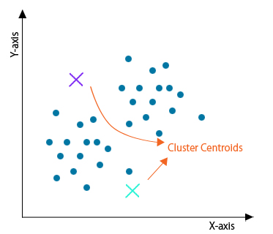
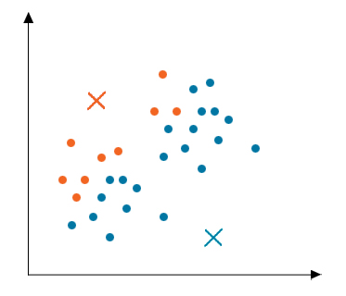
Steps: -
Step 1: Initialization: -
Firstly, initialize any random points called the centroids of the cluster
Step 2: Cluster Assignment
After initialization, all data points are traversed, and the distance between all the centroids and the data points are calculated

Slide 7
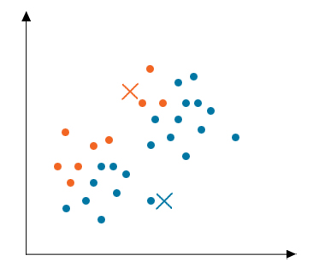
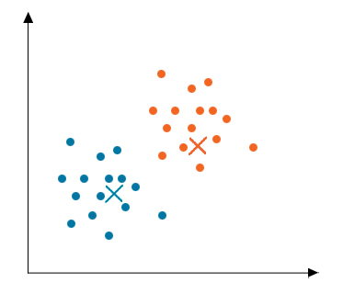
Step 3: Moving Centroid
As the clusters formed in the above step are not optimized, so we need to form optimized clusters. For this, we need to move the centroids iteratively to a new location. Take data points of one cluster, compute their average and then move the centroid of that cluster to this new location. Repeat the same step for all other clusters.
Step 4: Optimization
The above two steps are done iteratively until the centroids stop moving, i.e. they do not change their positions anymore and have become static. Once this is done, the k- means algorithm is termed to be converged.
Step 5: Convergence
Now, this algorithm has converged, and distinct clusters are formed and clearly visible. This algorithm can give different results depending on how the clusters were initialized in the first step.

Slide 8
Let’s code

